Slide 1
Opportunities for students seeking to undertake research degrees at Macquarie University
Professor Jim Piper
(with Dr Jin Dayong)
Deputy Vice-Chancellor (Research)
Macquarie University,
Sydney, Australia
jim.piper@mq.edu.au
dayong.jin@mq.edu.au

Slide 2
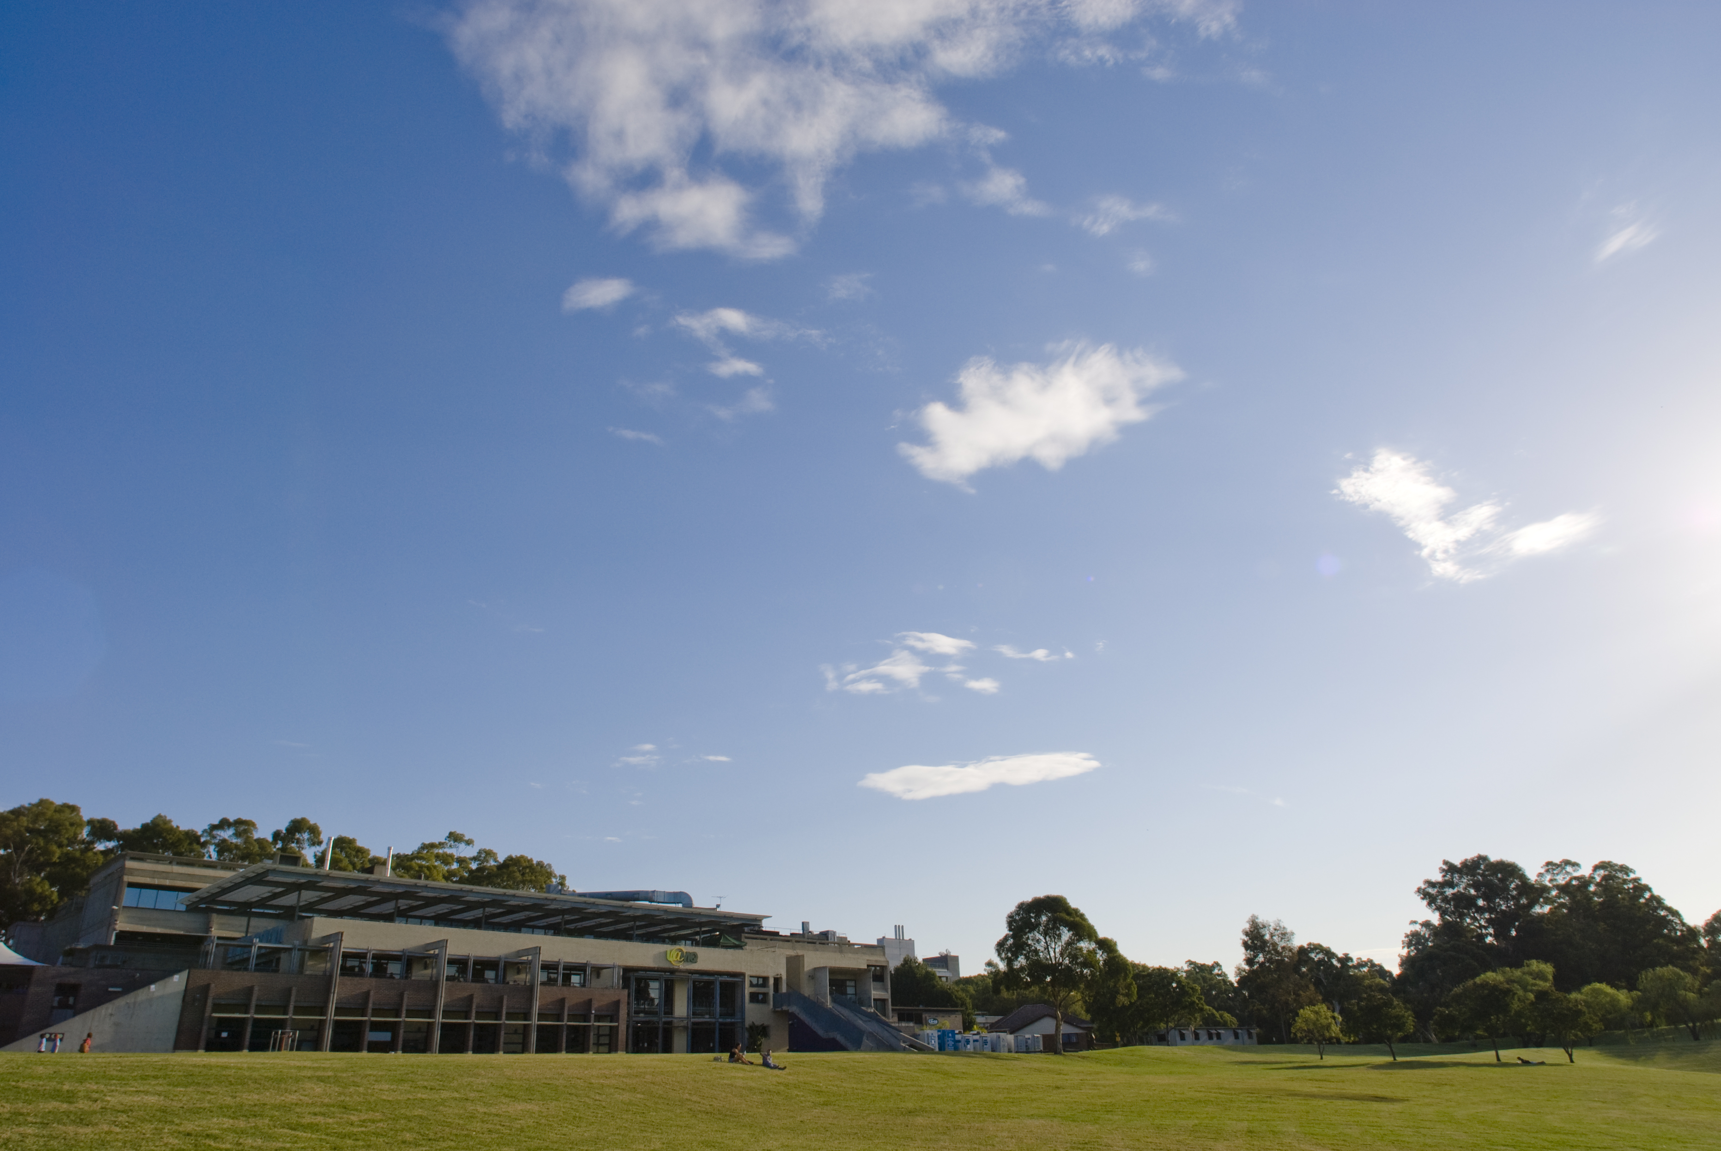
Macquarie University
Macquarie University is located in Sydney, Australia, on a 126 hectare parkland campus
The university has over 38,000 students including 12,000 international students
There are 4 Faculties: Arts, Business & Economics, Human Sciences and Science (incl. engineering); and 2 Schools (Management and Advanced Medicine)
There are 25,000 undergraduate students, 11,000 professional Master students, and 2,000 research students (over 90% PhD)
www.mq.edu.au

Slide 3
Macquarie University
World Universities ranking (Shanghai Jiao Tong) for MQU in 2011 was 252, improved by 44 places since 2006, and in the top 9 Australian universities)
MQU is ranked by QS as #16 in the top 50 world universities under the age of 50 (the leading Australian university under age 50)
Assessments of research quality in Australian Universities by Government (ERA) has determined MQU has over 20% of research activity at world-leading standard (top 4) and 80% at or above world-average (top 8)
MQU is the leading Australian university in Environment and Ecology , ranked #11 in the world for citations/paper
www.mq.edu.au

Slide 4
Macquarie University
National Research Centres and Facilities
ARC Centres of Excellence:
Engineered Quantum Systems
Cognition and its Disorders
Core to Crust Fluid Systems
Ultrahigh-bandwidth Devices for Optical Systems
Cooperative Research Centres
Environmental Biotechnology
Hearing
Capital Markets
National Collaborative Research Infrastructure
Australian Proteome Analysis Facility
Australian National Fabrication Facility
Other National Research Centres
National Climate Change Adaptation Research Facility
Sydney Inst. for Marine Science
Centre for International Finance and Regulation

Slide 5
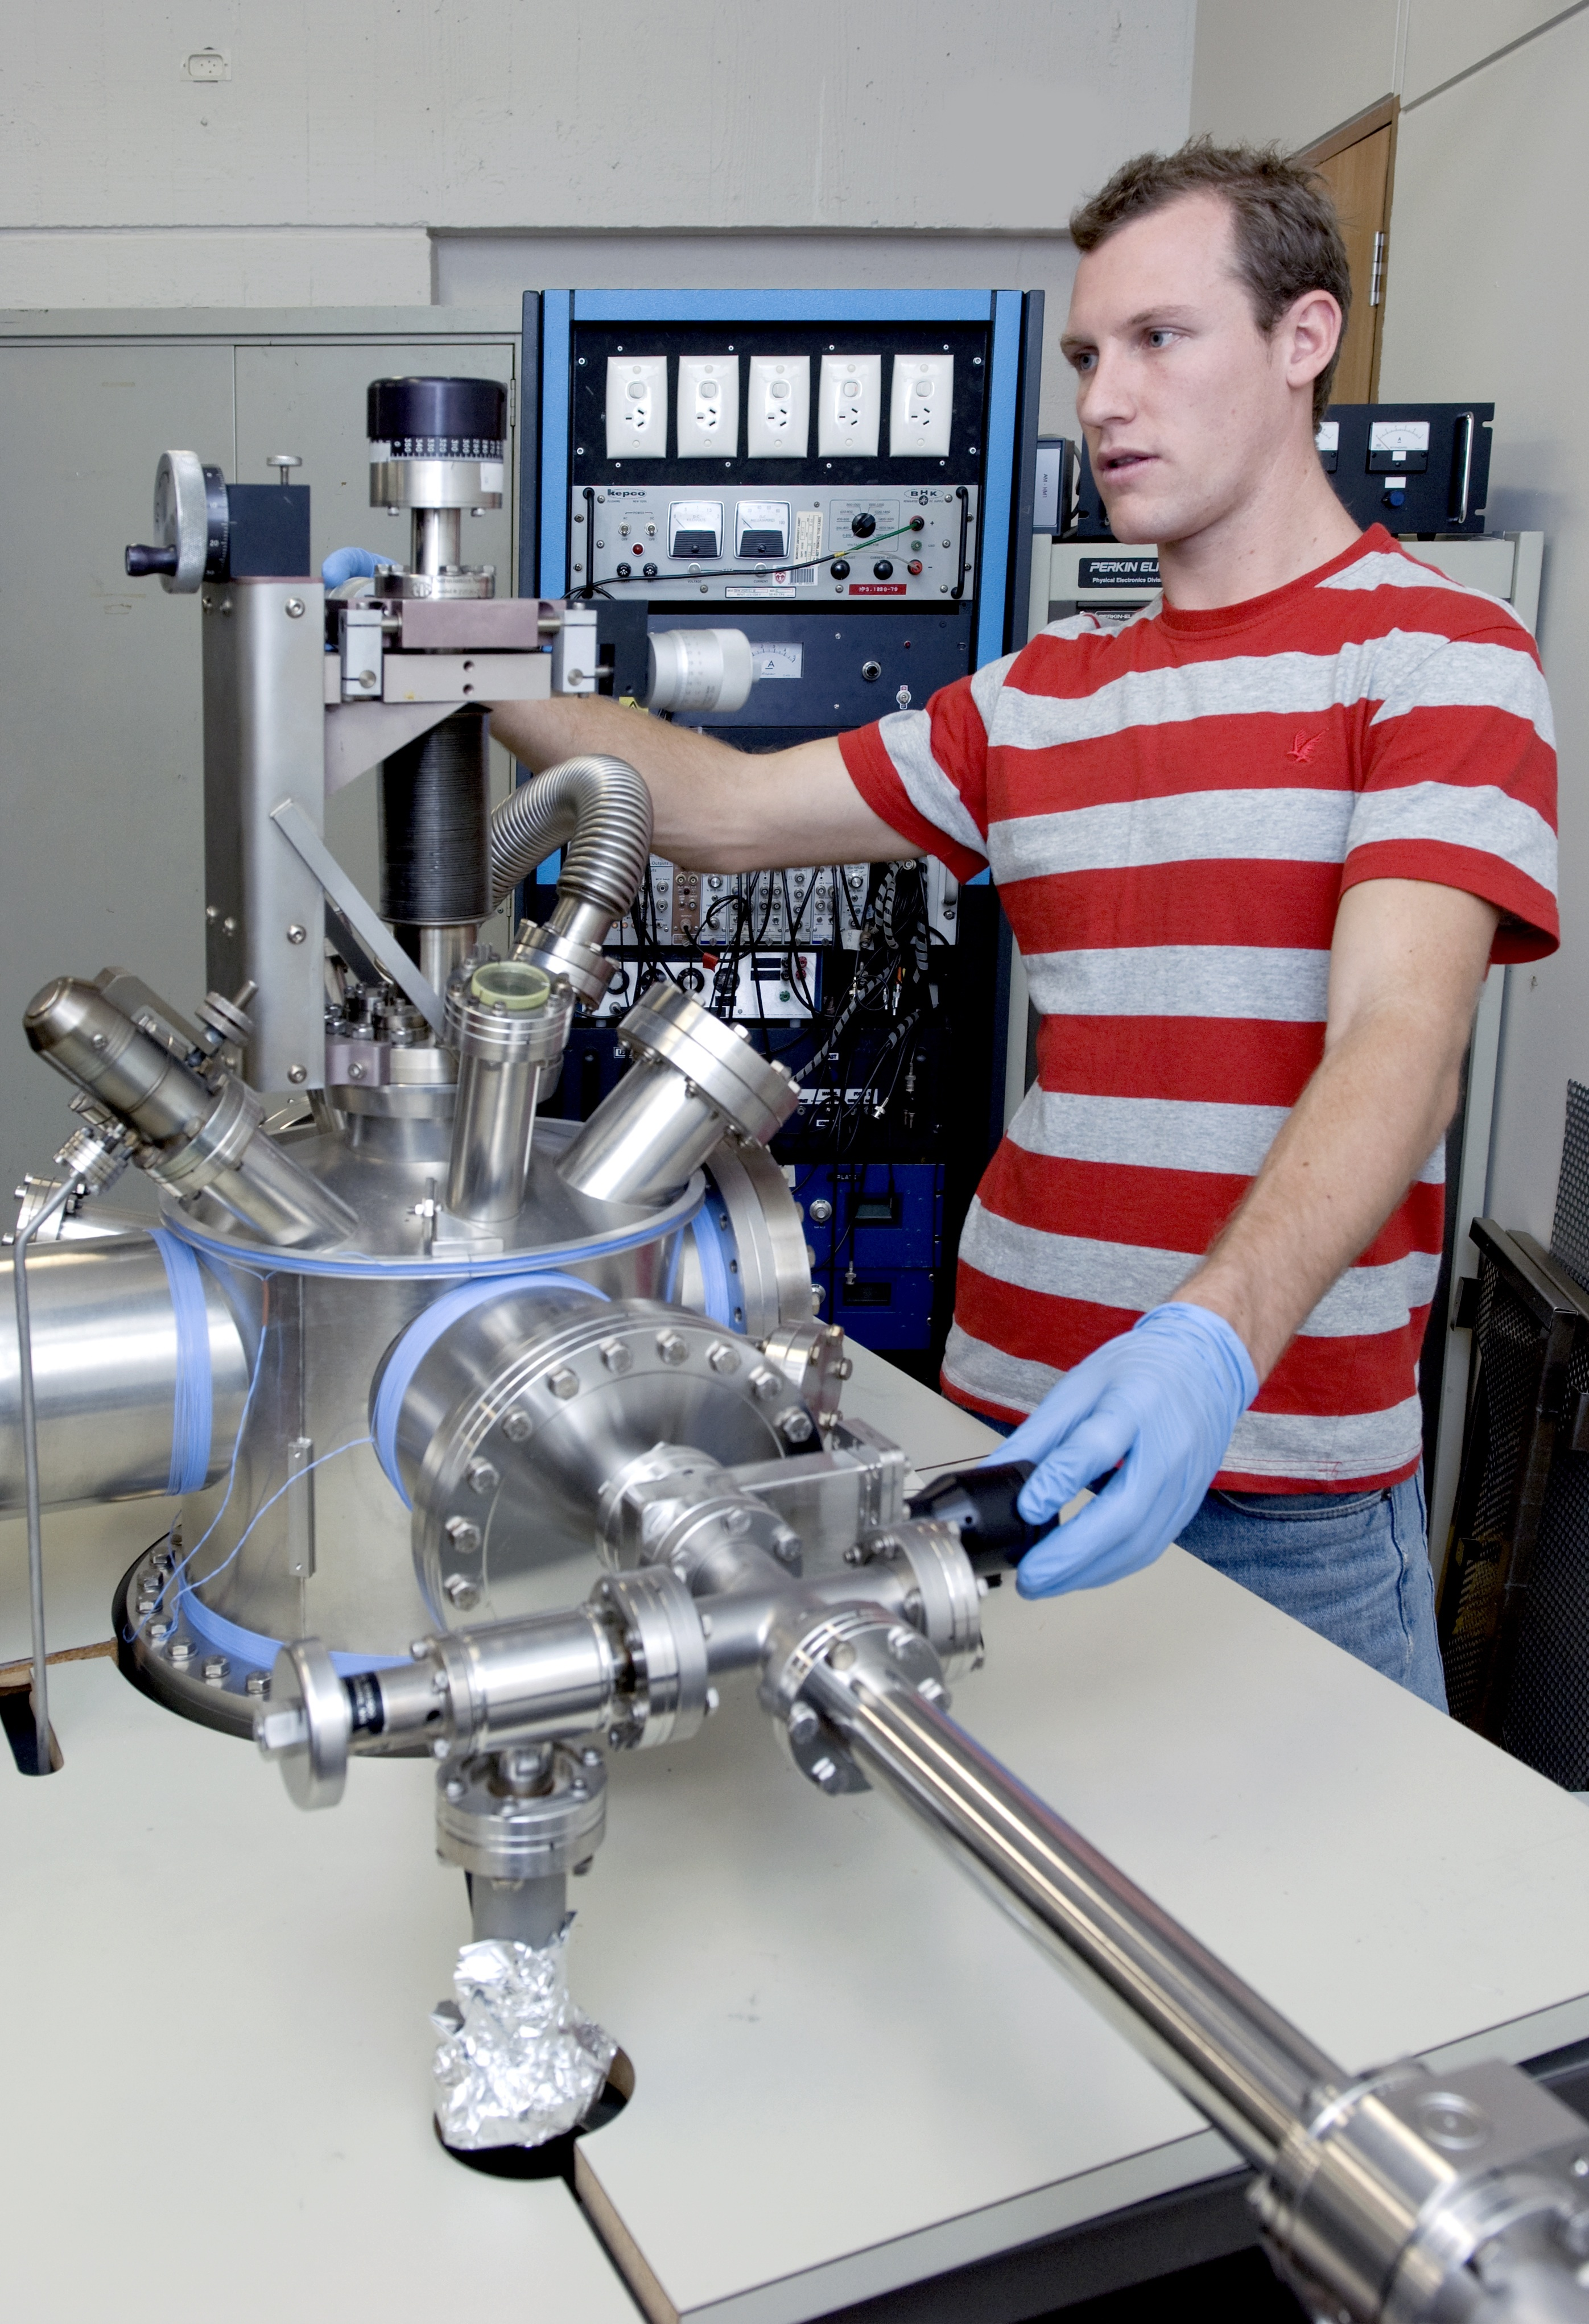
Macquarie University
Key research strengths
- FACULTY OF SCIENCE
Animal behaviour 动物行为学
Astronomy & astrophysics
天文及天体物理学
Biomolecular frontiers 生物分子领域
Climate risk 气候危机
Ecology & evolution 生态与进化学
Earth & planetary evolution 地球和行星进化
Lasers & photonics 激光与光子学
Quantum information science & security
量子信息科学和安全
Wireless communications 无线通信

Slide 6
Macquarie University
Key research strengths
- FACULTY OF HUMAN SCIENCE and SCHOOL of MEDICINE
Cognitive science 认知科学
Emotional health 情绪健康
Language sciences 语言科学
Neuroscience, vascular sciences & surgery
神经系统科学，血管科学和外科学

Slide 7
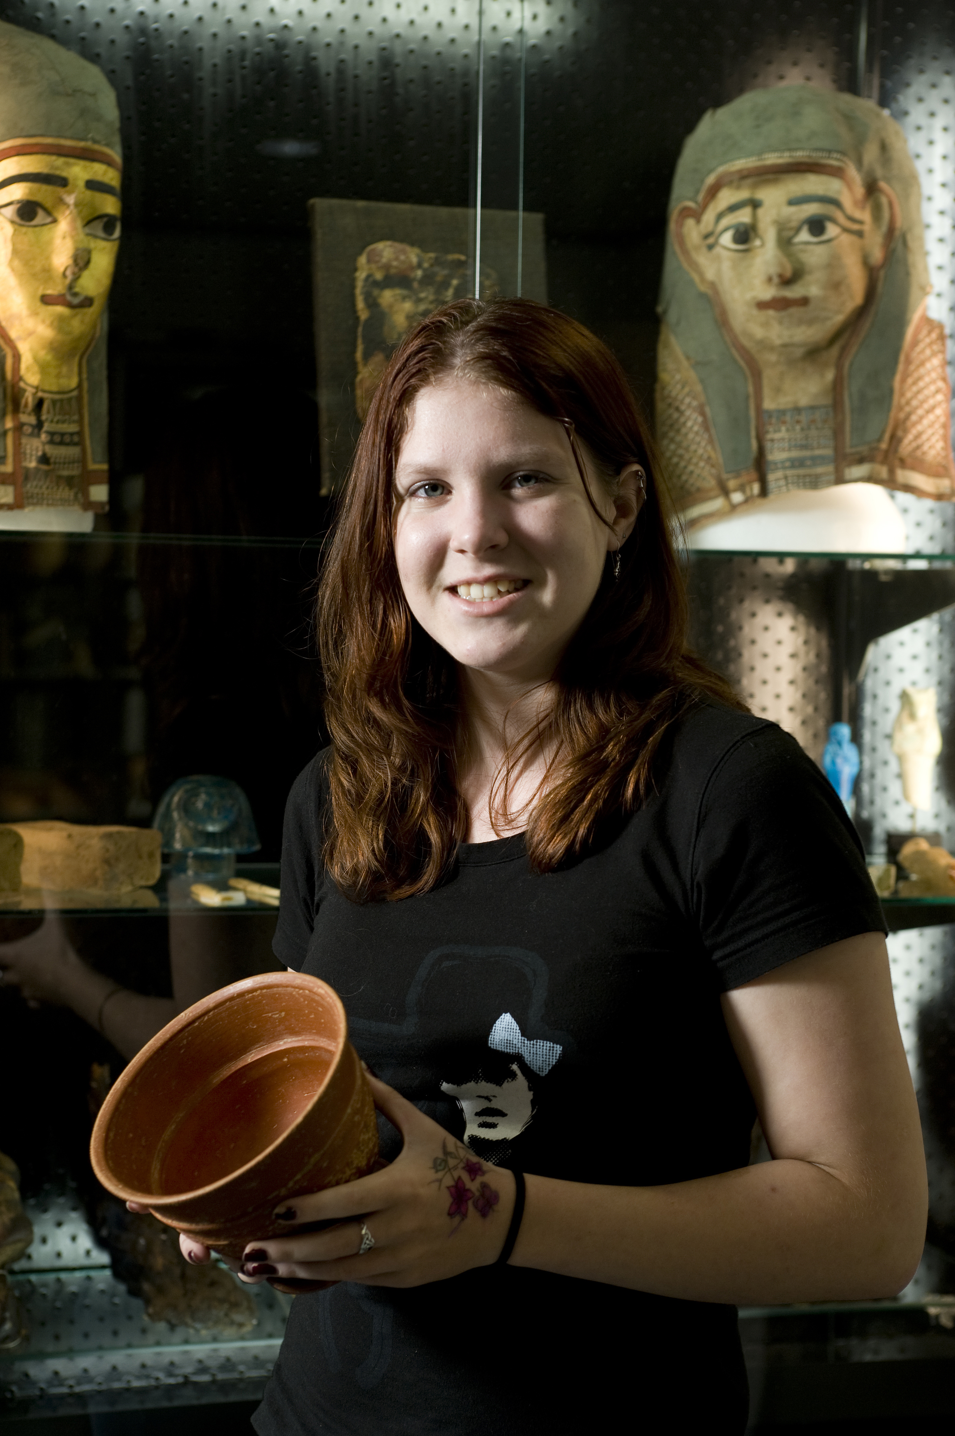
Macquarie University
Key research strengths
- FACULTY OF ARTS
Ancient cultures古代文化
Legal governance 法治
Social, cultural and political change
社会，文化和政治变化
Social inclusion 社会融合
- FACULTY OF BUSINESS & COMMERCE
  Financial risk 金融风险

Slide 8
Master of Research as pathway to PhD
A degree program of advanced study and research training that:
offers depth and breadth of formal study in the discipline comparable to international standards for graduate programs
prepares students for ongoing research at PhD level in a structured and efficient manner
stands alone as high-quality advanced degree giving competitive advantage in the job market
acts to increase the number of Australian students undertaking academic studies at an advanced level in their discipline
substantially improves the completion times and numbers for PhDs
increases international market competitiveness of Australian PhDs for intending research students
provides better articulation and joint-PhD options with overseas universities

Slide 9
Master of Research program
  Admission will require Credit average for Bachelor degree
  Yr 1 program comprises 8 major units of coursework at advanced (700) level including
    6 units of study at advanced level in the relevant discipline(s)
    1 unit of study in Research Communications
    1 unit of study of Research Frontiers (generalist, in the discipline)
    Yr 2 comprises a structured graduate (800-level) program of preparation, planning and implementation of a major research project encompassing specific milestones
    Research methods and skills development specific to discipline
    Major literature review and analysis of current research frontiers
    Project definition and plan
    Foundation research project and 20,000-word thesis

Slide 10
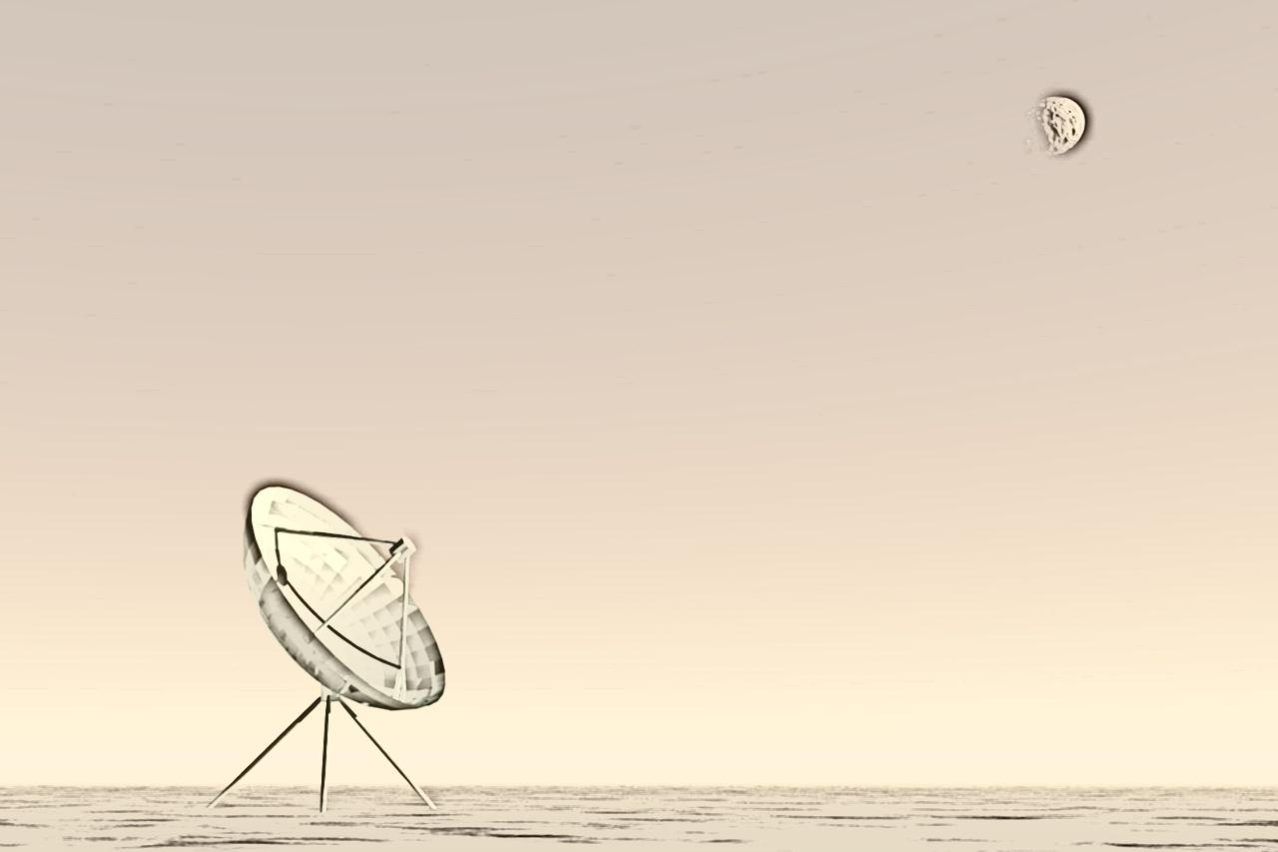
Example of MRes Yr 1 - Physics
700-level in Physics
  Research Communications
  Research Frontiers in Physics and Astronomy
  Plus an approved program of 6 units usually taken from these electives:
    Advanced Photonics;
    Mathematical Methods in Physics;
    Statistical Physics;
    Computational Science;
    Nanobiophotonics;
    Quantum Information and Technology;
    Advanced Astrophysics;
    Particle Physics and Cosmology.

Slide 11
Master of Research/PhD packages
From 2014, admission to PhD will require a completed MRes at distinction level (75%) or completed research Master degree
Students who have completed a coursework Master degree or the coursework component of a research Master degree (China) receive full credit for the Year 1 of MRes and enrol in a 4 yr MRes/PhD
Students with a completed Bachelor degree (at Credit level) may enrol in a 5 yr MRes/PhD package with progression subject to performance
Students who have completed a research Master degree may enrol directly in a PhD (normally 3 yrs duration, but with an additional 6-month confirmation period applying to most international students)
Full and partial scholarships (including tuition fees) for international students will be available for both 5 and 4 yr MRes/PhD packages, as well as 3 ½ yr PhD programs
Macquarie University has a special agreement with Jilin University whereby for every Jilin student awarded a CSC Scholarship to study at Macquarie, we will offer a matching scholarship to another Jilin student

Slide 12
Joint MRes/PhD programs
Macquarie University has a strong commitment to developing research collaboration through joint PhD programs-over 100 PhD students are currently undertaking joint PhD programs with leading universities in Europe/UK, China, and elsewhere in Asia
Joint PhD programs involve joint supervision and examination, and a significant period (minimum 1year) spent at each university, with the student receiving the PhD from both Universities
Jilin and Macquarie University have an agreement enabling joint PhDs including full scholarships for tuition fees and living allowance
Joint research Master programs are possible where the student receives the Master degree from both universities
Jilin and Macquarie are planning a 2 yr coursework (Jilin) + 1yr research training component (Macquarie) with full scholarships for the 3rd year, likely to commence 2014

Slide 13
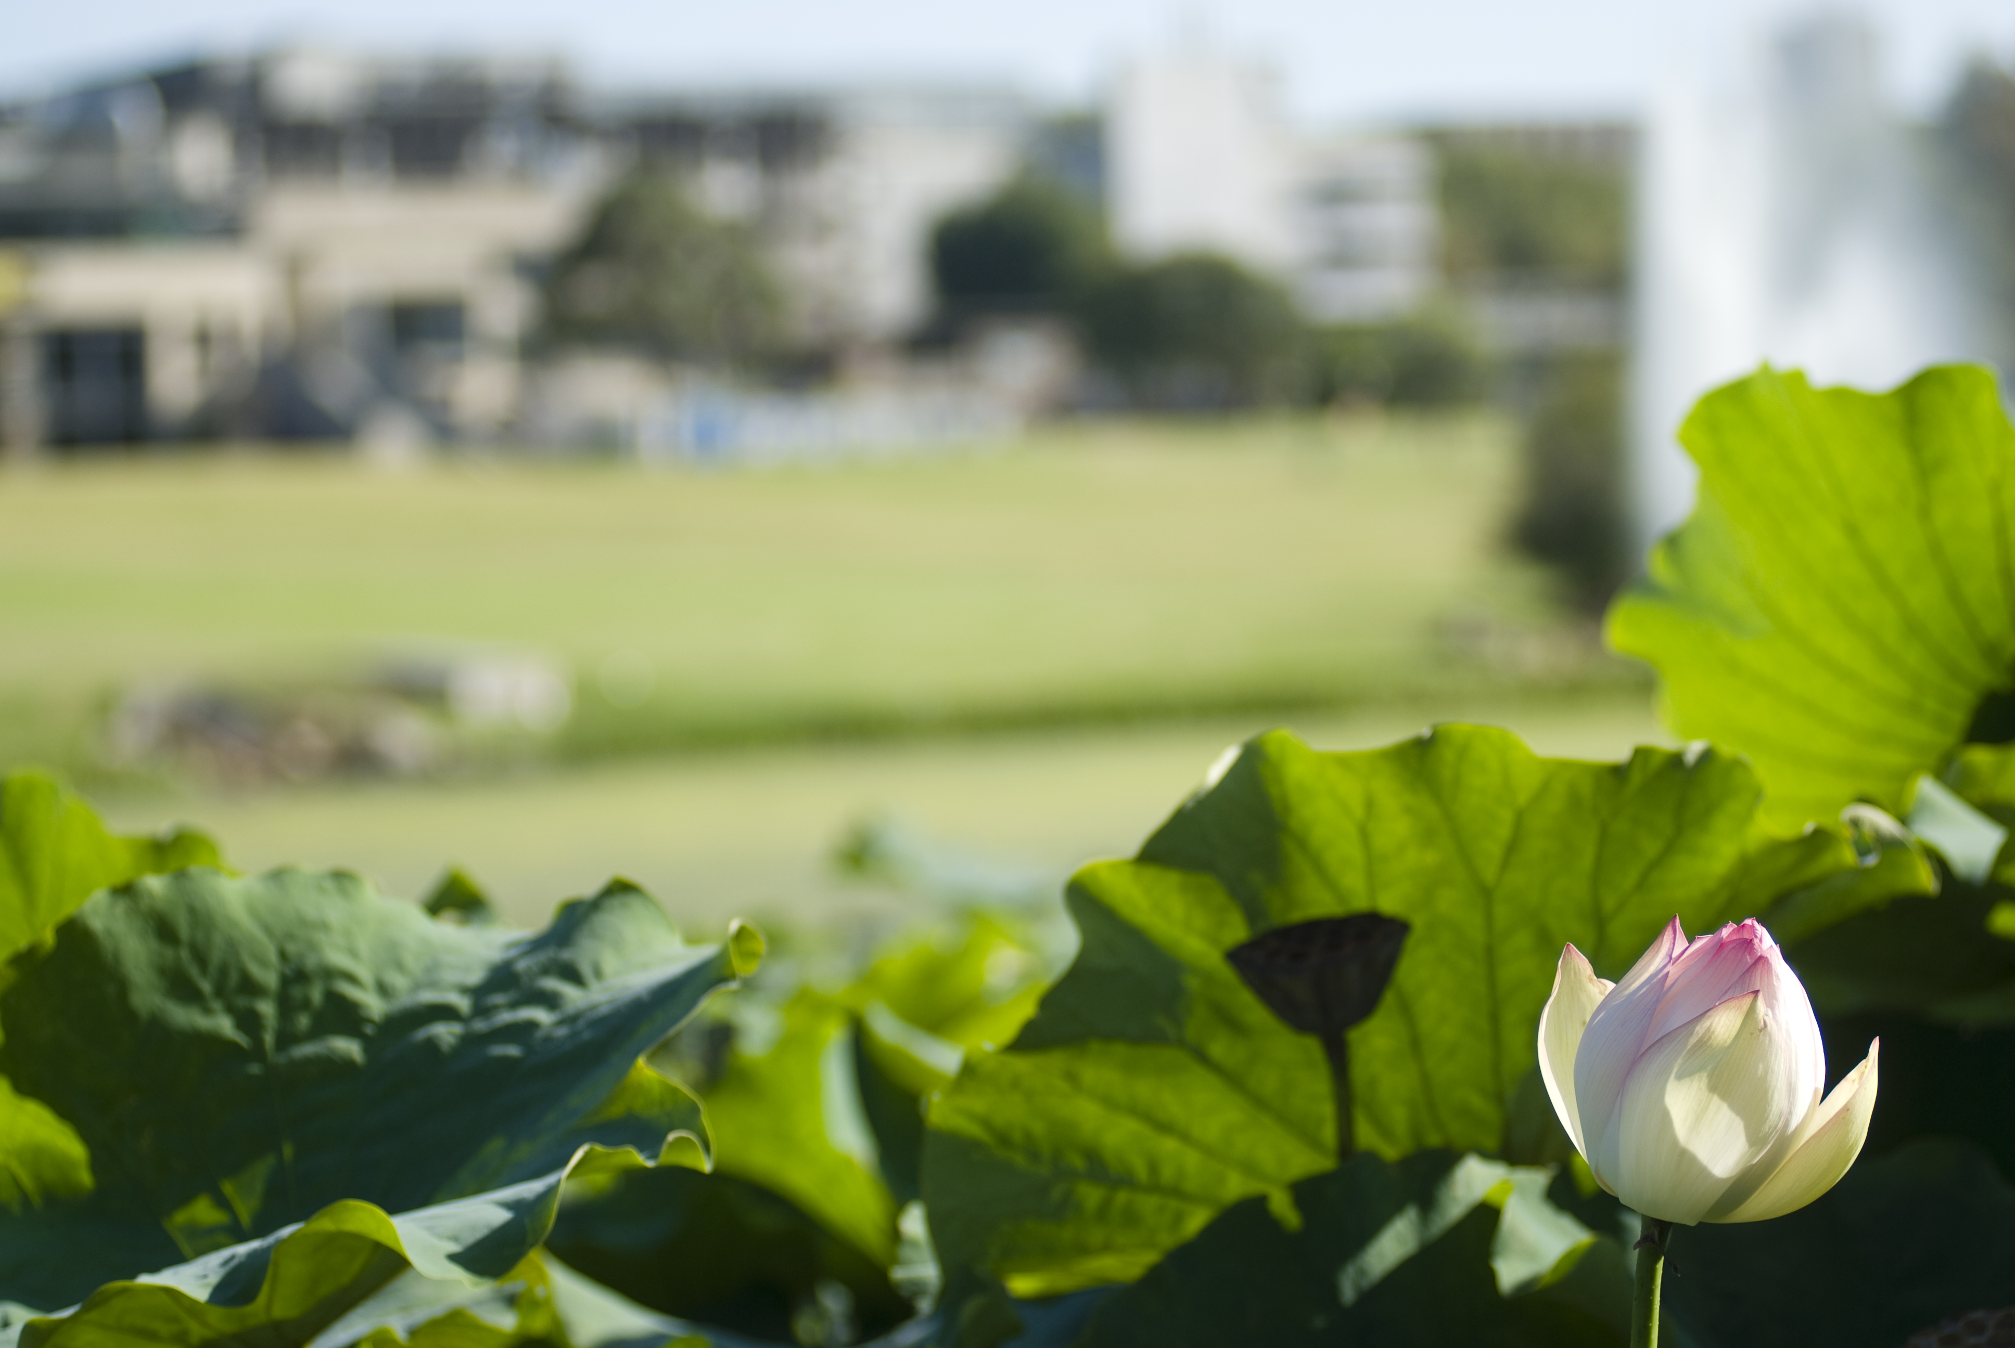

Thank you for coming
Welcome to Macquarie University
www.mq.edu.au
CRICOS CODE 00002J
Notes:
No video/animation.

