Slide 1
Graduate Studies at Queen’s
Dr. Zhiyao Zhang
Director, Queen’s China Liaison Office
the IGSF 2015 International Graduate Scholarship Fair
Beijing, Wuhan, Nanjing, and Shanghai

Slide 2
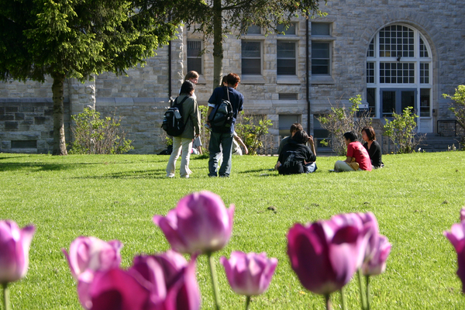
Graduate Studies at Queen’s

Slide 3
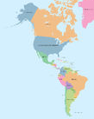
Kingston

Slide 4
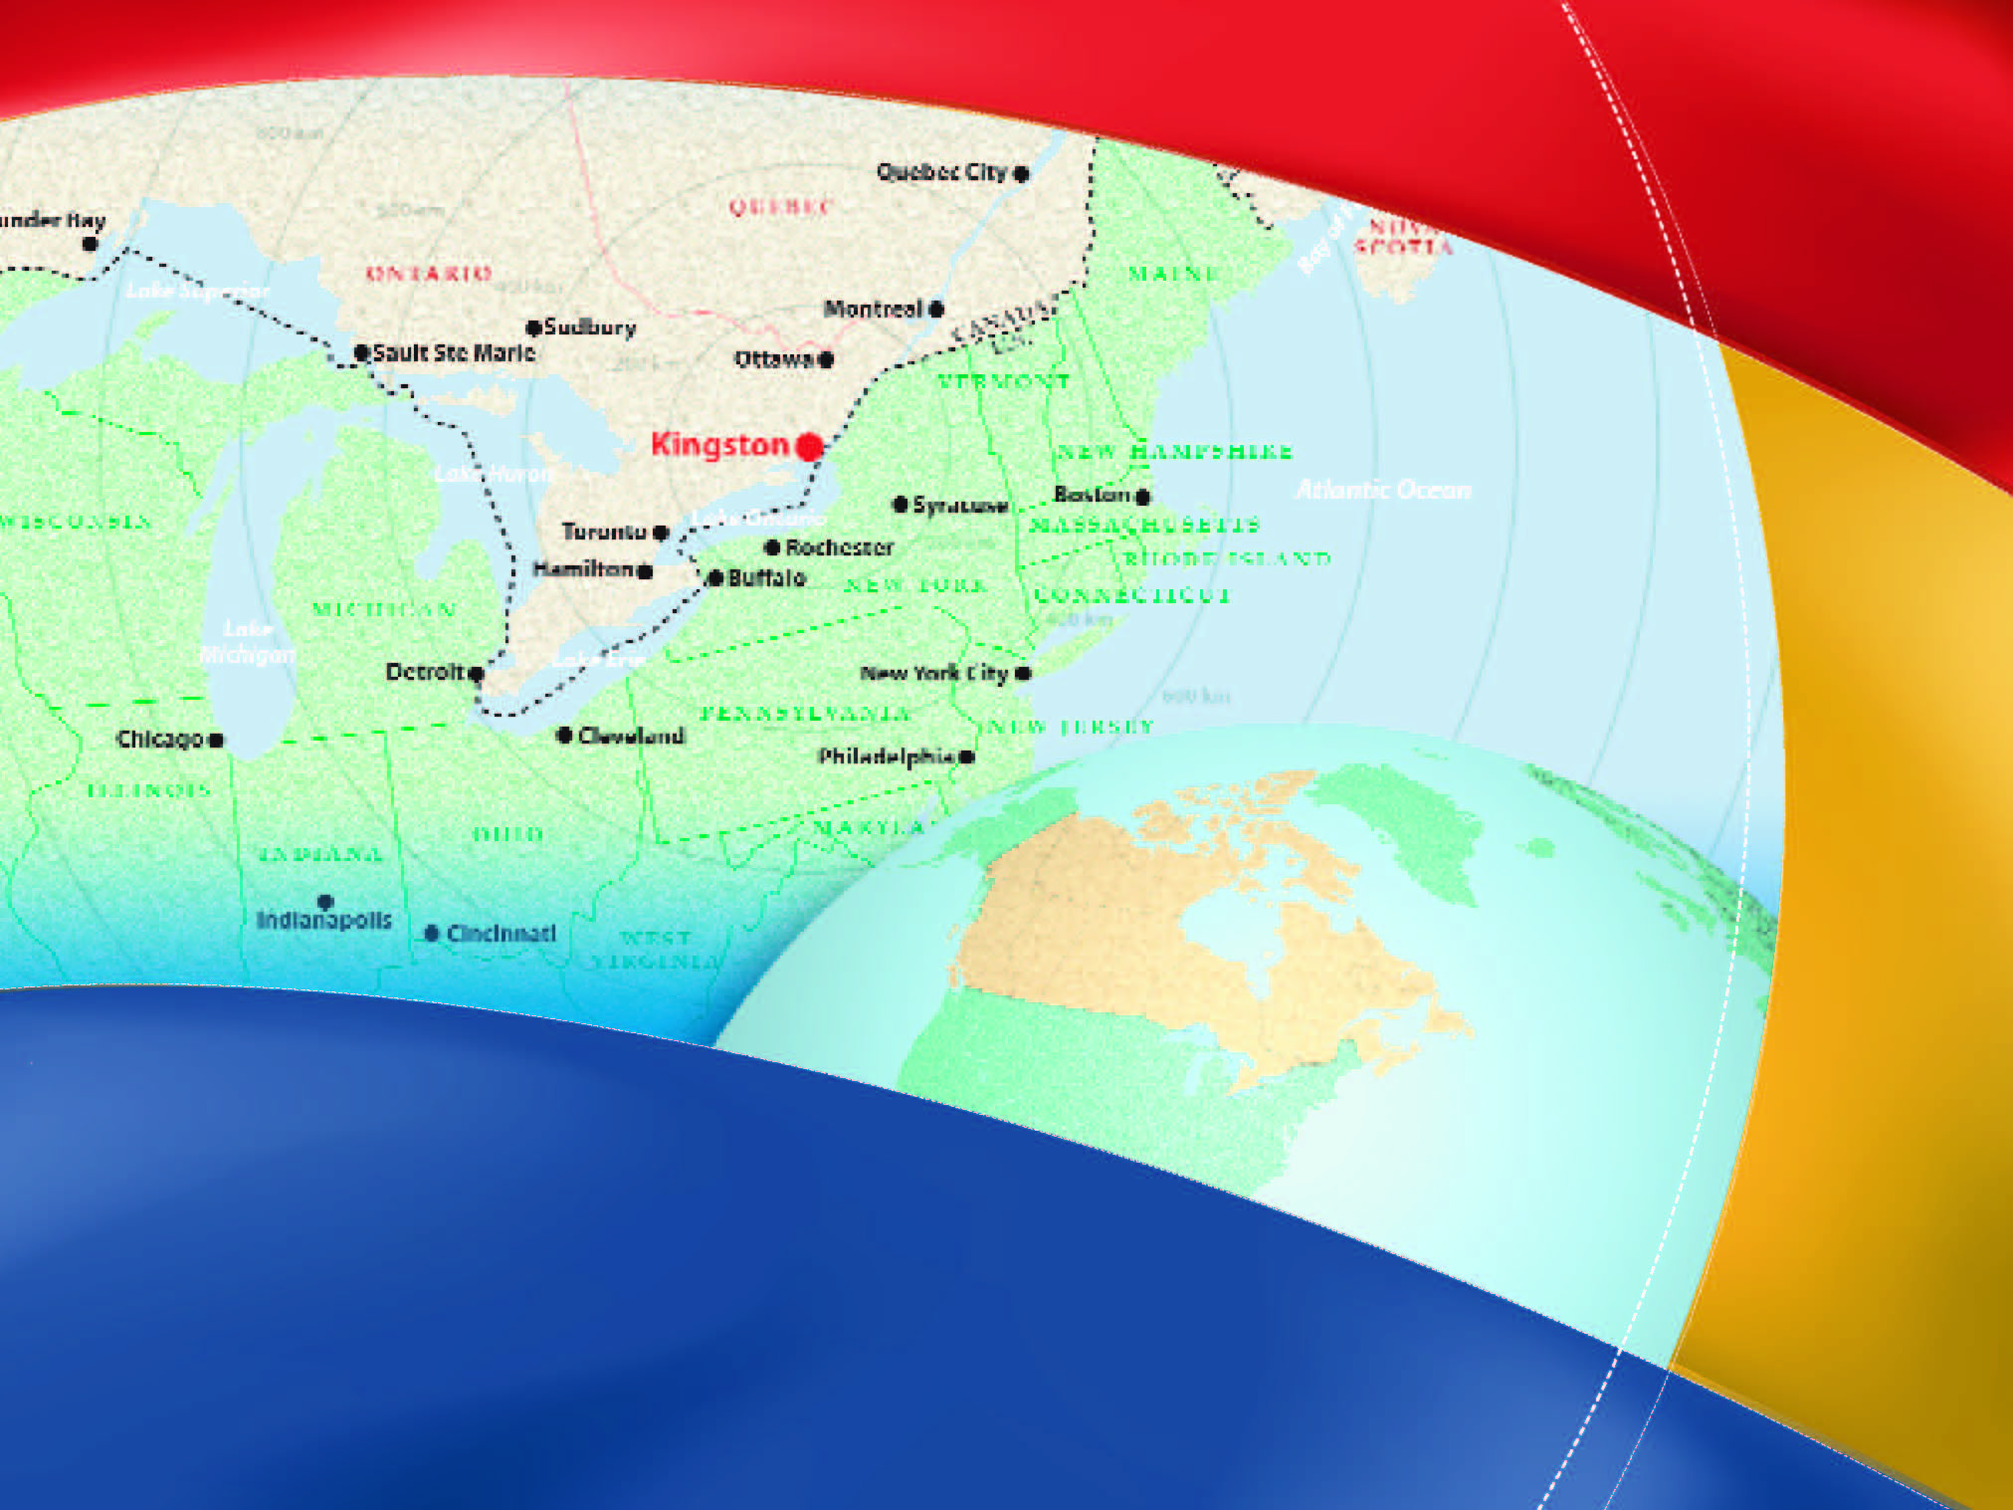

Slide 6
Outline
About Kingston & Queen’s
Research at Queen’s
Graduate Studies
Our Students
How to Apply

Slide 7
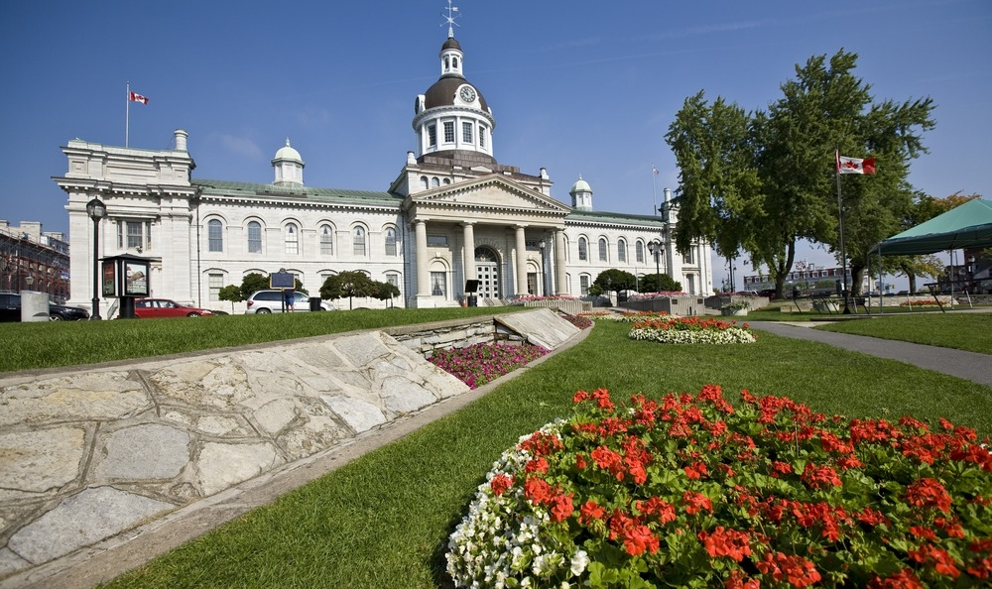
Kingston is home to Queen’s University
It is a vibrant, midsize city of 150,000
and was Canada’s first capital city

Slide 8
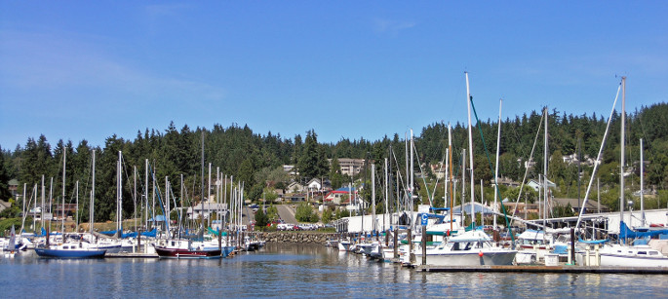
Kingston ranks in the top 5 of the world’s best university towns to live in (BBC)
A historic city with more than 21 national heritage sites
Located on the shore of Lake Ontario

Slide 9
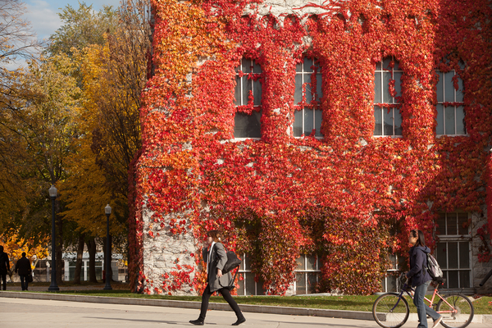
Queen’s University was founded in 1841 –
the earliest degree-granting institution in the United Province of Canada
Current full-time enrolment is over 21,000 students

Slide 10
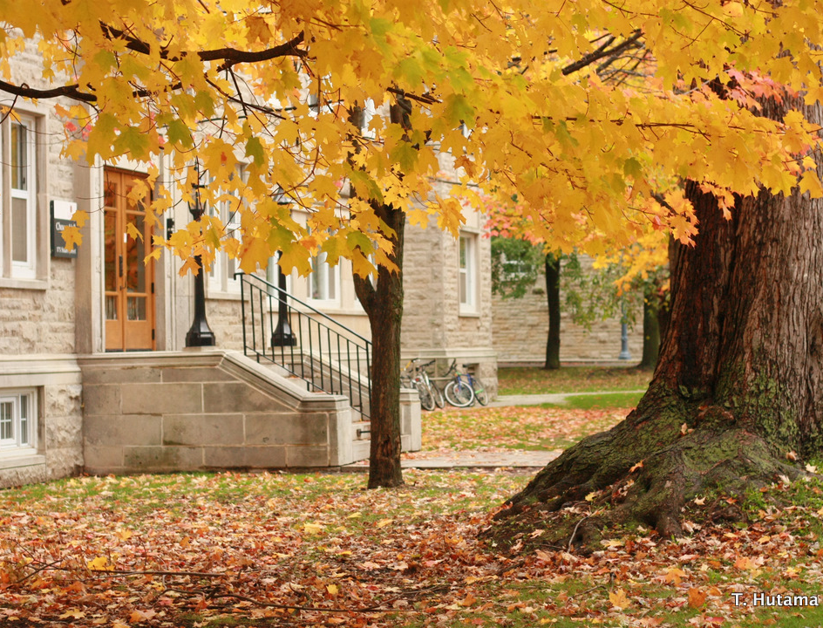
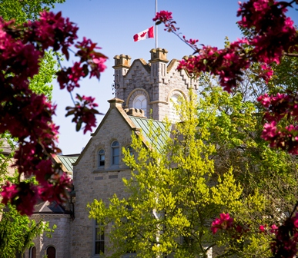
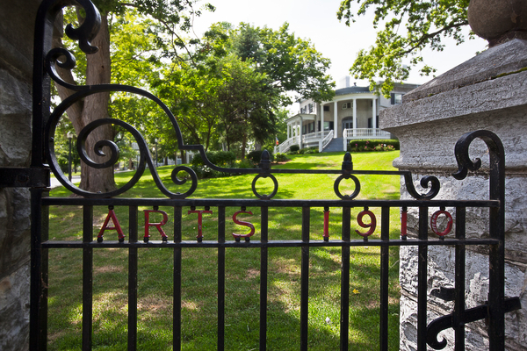
Four seasons at Queen’s
The four seasons at Queen’s

Slide 11
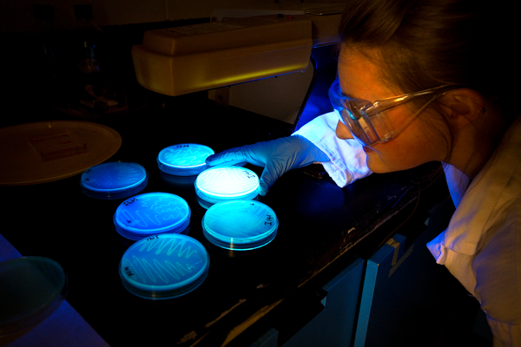
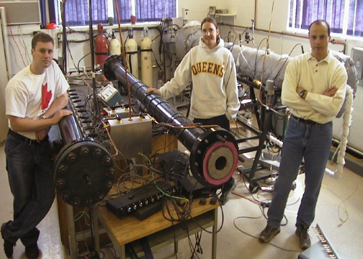
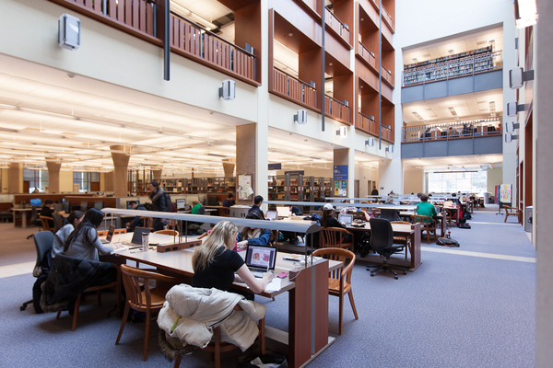
Research
Since 2003, Queen’s
ranks 1st in Canada in the number of awards and prizes per full-time faculty member
External investment in research exceeded $168M in 2013

Slide 12
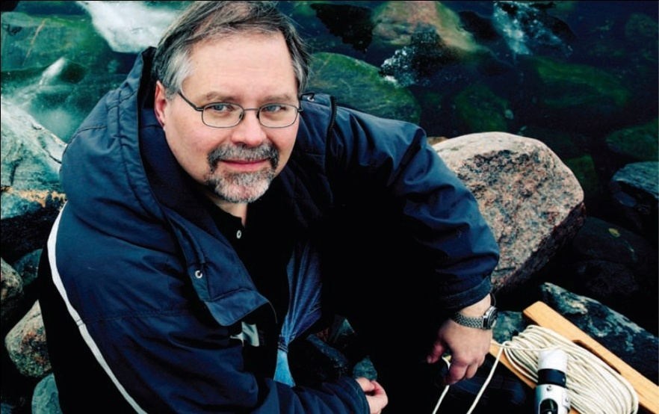
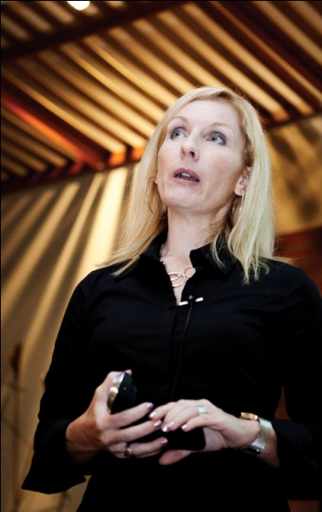
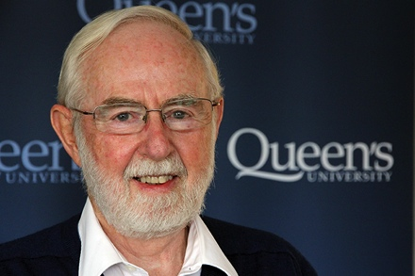
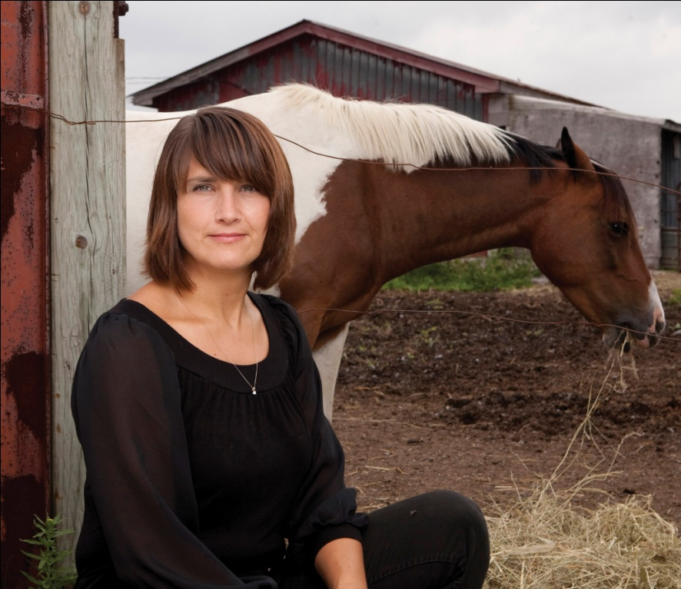
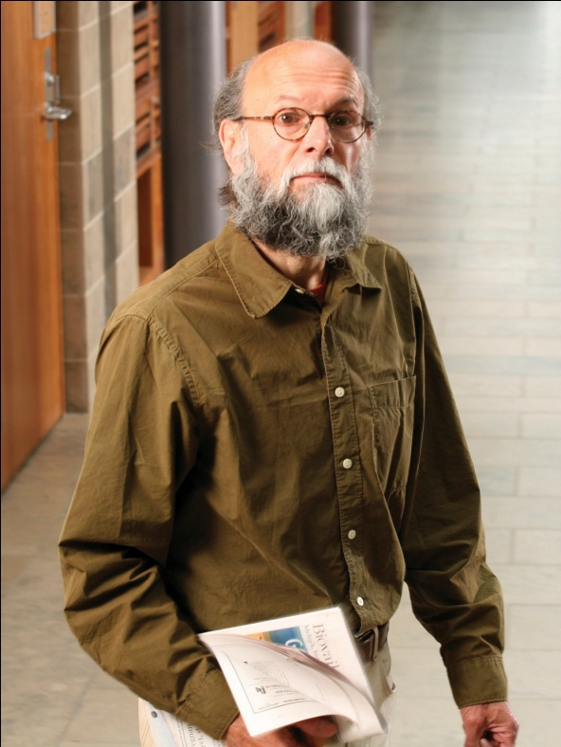
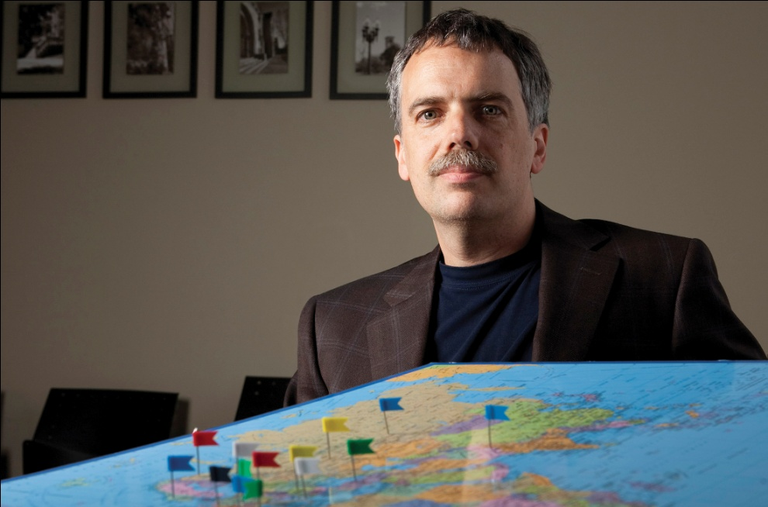
QUALITY
AND EXCELLENCE
Learn from the country’s
foremost innovators and scholars
Notes:
Queen’s faculty win more awards than at any other Canadian university and have been educated around the world (ie. Yale, Harvard, Oxford)
A cycle of outstanding students attract outstanding professors and vice versa
Professors are doing innovative research, with countless opportunities for student involvement at the undergraduate level
Quality and excellence in the programs and facilities at Queen’s – home to Chernoff Hall, an award-winning chemistry complex, one of the largest of its kind in North America, also home to a state-of-the-art Integrated Learning Centre which functions as a “live building”. Home to a Cancer Research Institute, home to the National Cancer Institute’s Clinical Trials Group
Queen’s has 16 research centres on campus
Exceptional library resources, ranked #1 in Canada for library acquisitions and for library holdings per student

Slide 13
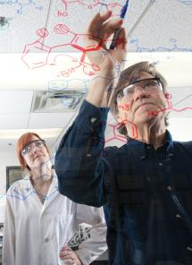
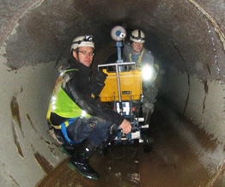
Innovation Park
Provides an environment where academia, industry, government & community work together to advance discoveries and technology
PARTEQ Innovations
Founded to commercialize Queen’s research and
bring discoveries
into the marketplace

Slide 14
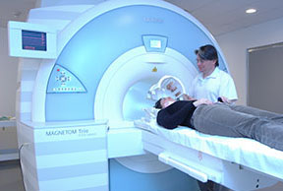
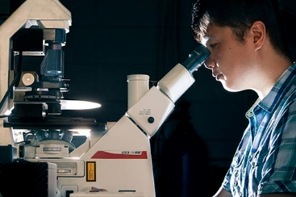
Research Centres
International and Defence Policy
Energy and Power Electronics
GeoEngineering
Canadian Institute for Military & Veteran Health Research
Cancer Research Institute
Centre for Neuroscience
Fuel Cell Research

Slide 15
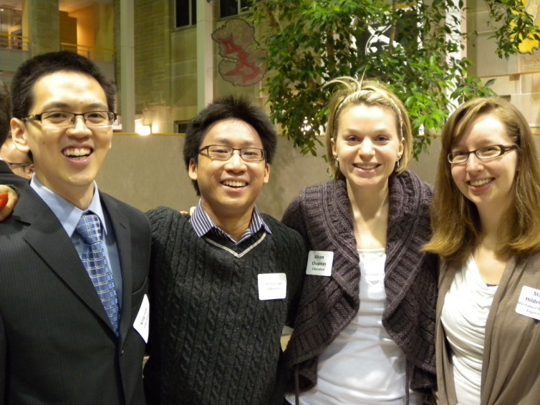
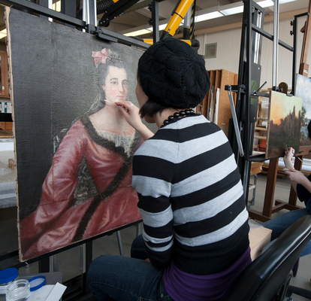
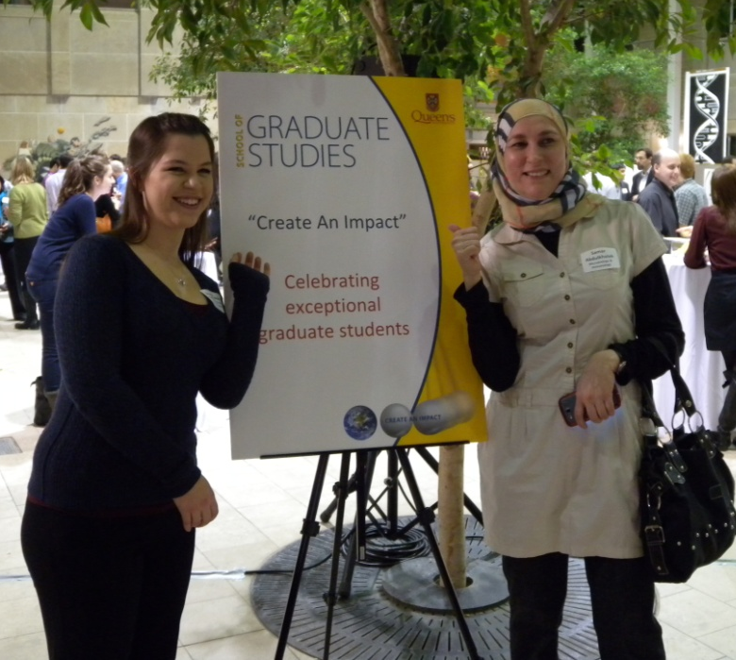
Graduate Studies
http://www.queensu.ca/sgs/

Slide 16
Over 120 degree programs in areas of:
Health (Life) Sciences
Engineering and Applied Science
Mathematics and Physical Sciences
Social Sciences and Professional Schools
Humanities
Professional degree programs, research-based Master’s and PhD studies
Combined undergrad/grad programs (4+1)
Accelerated route to PhD
Guaranteed funding support for
research graduate students ($34M)

Slide 17
The Numbers
Highest doctoral completion rate in the U15
(81.3%)
83% Master’s completion rate
3000 Master’s and 1100 PhD students
45 Canada Research Chairs
27 Research Chairs
~ 44 Fellows of the Royal Society of Canada
Ranked 3rd in U15 (1st in Ontario) in number of Tri-council awards received by our graduate
students
Notes:
9 year completion U15 avg: 68.5%; Mac next highest at 75.2%
Master’s highest is 86% (Western, wtloo 83.3; U15 avg 74.1%
Quality of experience (red= national data) all from 2013 CGPSS
Recipient rate : UBC 18.8% and Dal @ 24.4; McGill in 4th @ 17%; UT 15.7% (U15 avg 15.34%)

Slide 18
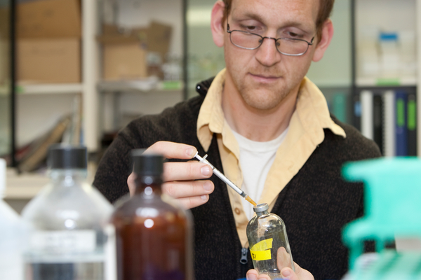
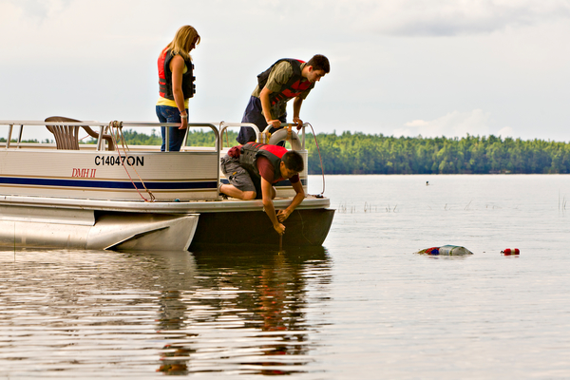
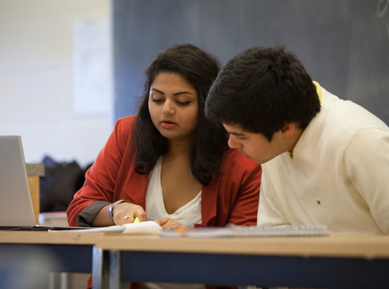
Graduate Students
Over 4,000 graduate students; 20% of the total enrolment at Queen’s
Among the highest degree completion rates in Canada
Over 90% of students report the quality of their academic experience as good to excellent
Receive excellent mentorship

Slide 19
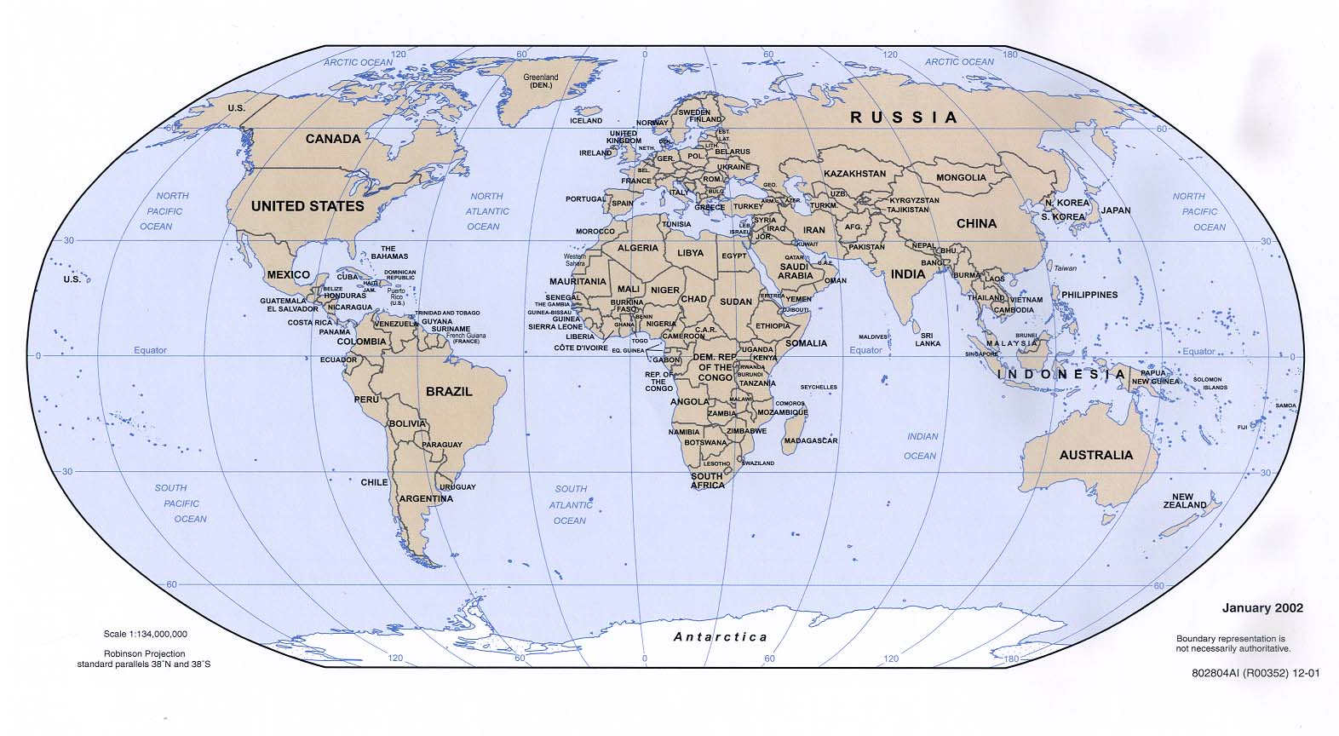
20% of our graduate students are from countries other than Canada
Notes:
72 countries,
>15% enrolment in SGS; >22% enrolment SGS + QSB

Slide 20
Internationalization of Queen’s and Queen’s in China
More than 100 partner institutions around the globe
Member of the Matariki Network of Universities
BISC-Herstmonceux Castle in Southeastern England
Notes:
72 countries,
>15% enrolment in SGS; >22% enrolment SGS + QSB

Slide 21
Matariki Network of Universities
Dartmouth College
New Hampshire, United States of America
Durham University
Durham, England
Queen’s University
Kingston, Canada
University of Otago
Dunedin, New Zealand
University of Tübingen
Tübingen, Germany
The University of Western Australia
Perth, Australia
Uppsala University
Uppsala, Sweden

Slide 22
Matariki Network of Universities
*Strong links between research and undergraduate teaching;
*A rich learning environment, in which cultural and sporting activities, as well as social and community endeavours, feature alongside academic learning;
*Strong commitment to social and global responsibility.

Slide 23
jaiwei
Queen’s China Link
Major University Partners:
Fudan University, Tongji University, Renmin University of China, Jilin University, BJNU
Student exchange and other faculty links with SYSU，PKU,
Tsinghua U, SUFE, CEIBS,
Major Government Partners:
CELAP, CASS, CAS, CSC, MLR, SMGFAO
Queen’s China Liaison Office
Established 2007, located in Shanghai, it is for coordination of
anything Queen’s has to do in/on China: student recruitment,
academic programs, research collaboration, and alumni
relations

Slide 24
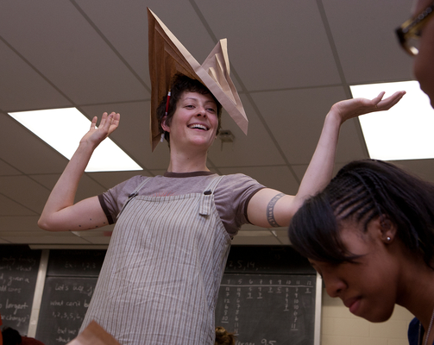
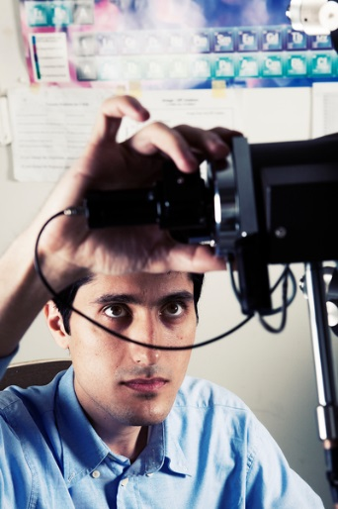
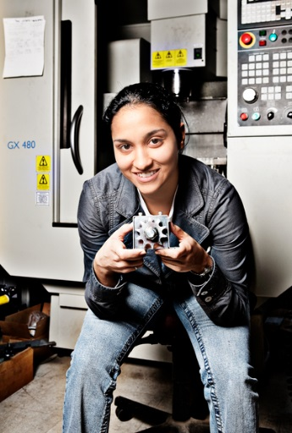
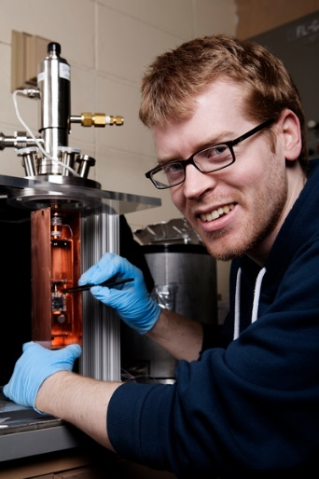
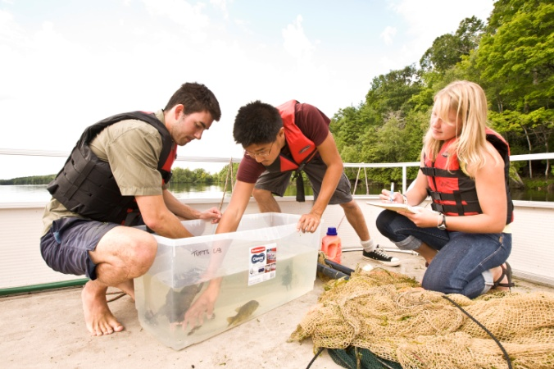
Become a part of the Queen’s Community! Here’s how to apply:
Visit: www.queensu.ca/sgs/ for program information and instructions on how to apply
Contact the department
about finding a
supervisor; indicate if
you have a scholarship
Complete the online
application and provide
necessary documents; check
departmental deadlines

Slide 25
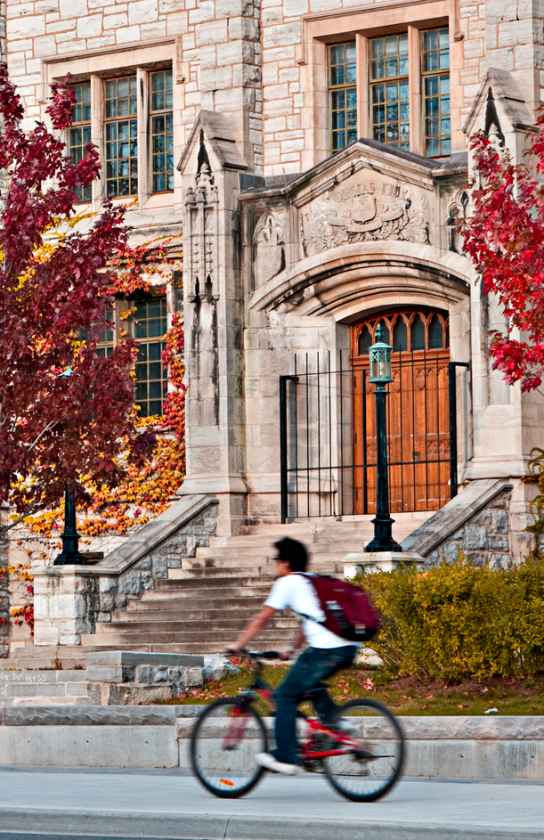
Options to Meet Language Requirements
1 year at a university with academic English instruction
Minimum IELTS, TOEFL, PTE or MELAB scores
A- in ESLA 150 of the English for Academic Purposes Program (EAP) at Queen’s School of English

Slide 26
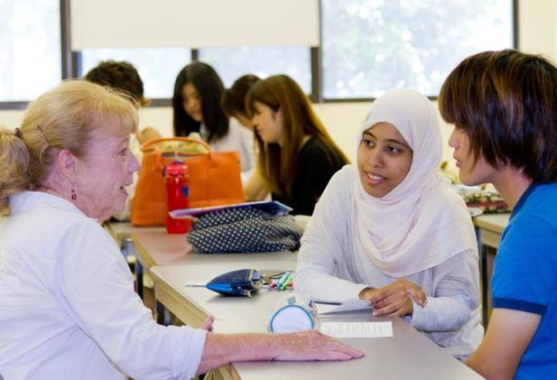
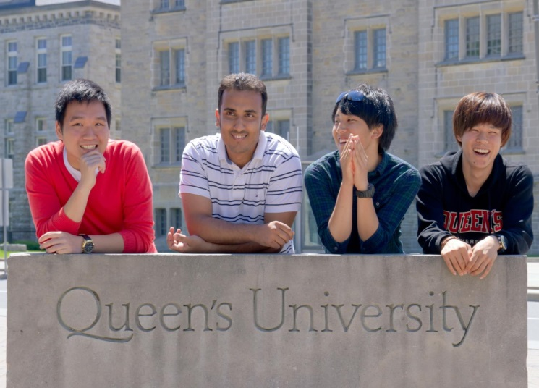
Queen’s School of English
Conditional Admission
For international students with scholarships that provide funding for English language studies
Minimum: IELTS 6.0, TOEFL iBT 71, or equivalent
1 to 3 sessions of the EAP Program with a final of A- in ESLA 150
www.queensu.ca/qsoe

Slide 27
For details on how to apply to Queen’s go to :
http://www.queensu.ca/sgs/prospective-students/international-students-partnerships
Programs: http://www.queensu.ca/sgs/prospective-students/programs-degrees

Slide 28
Thanks for your attention!

